Slide 1
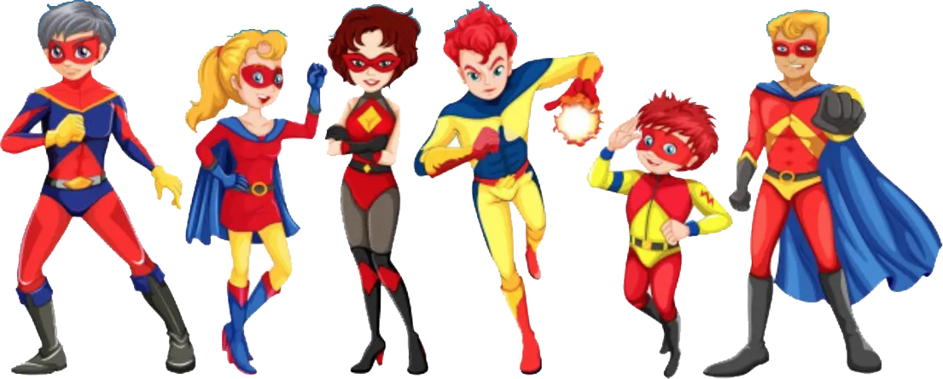
Super U event
Facebook Ad Campaign

Slide 2




About
It is a Global Shala competition that encourages high school and college level student to submit written or visual content on a real-world challenge and how to solve to it using their superhero power. Participants are encouraged to:
Imagine
Illustrate
Innovate
Inspire

Slide 3
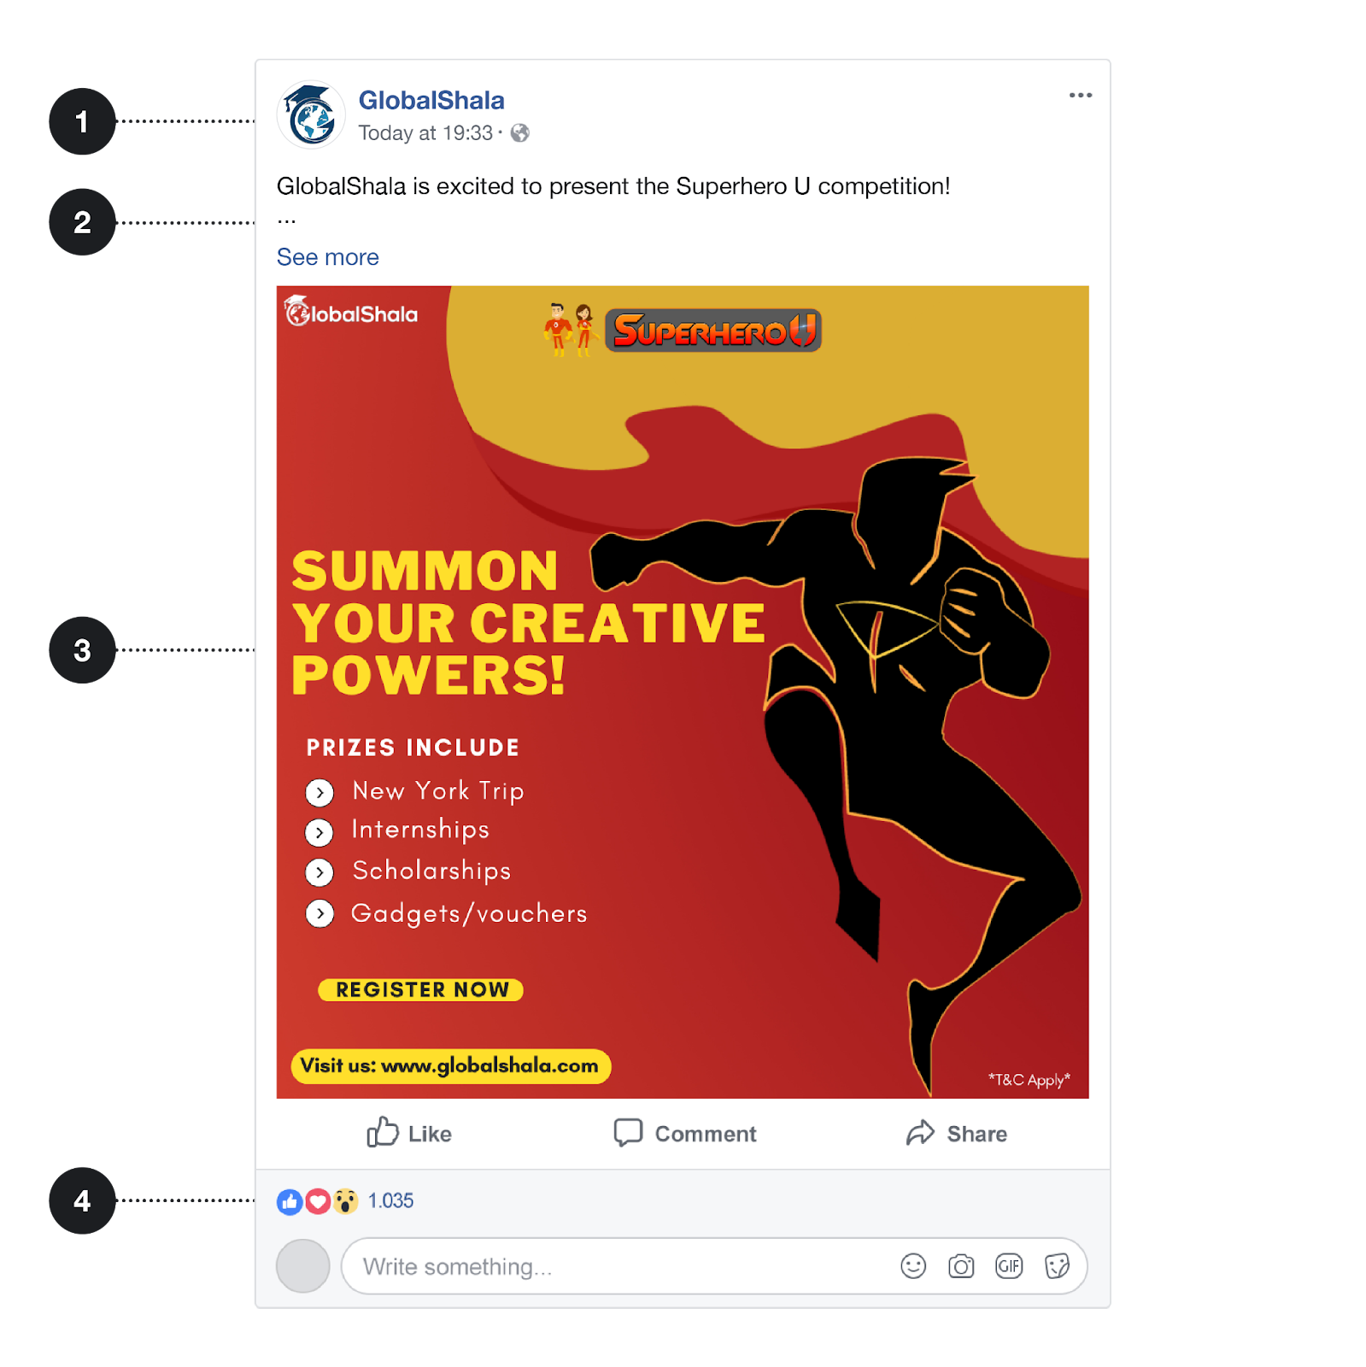

The Ads
GlobalShala placed Facebook ads targeting two different audiences, “students” and “educators and principals.” Here are examples of ads for each audience:

Slide 4
Overview
Highest Spenders:
Campaign1 spent the most at 2,333 INR, followed by Campaign 2 (1,579 INR) and Campaign 7 (1,035 INR).
Lowest Spenders:
Campaign 5 spent the least at 838 INR, with Campaigns 9, 3, and 10 spending marginally more (all under 900 INR).

Slide 5
Impression Vs Reach
Impressions
Highest Performing Campaigns:
Campaign 2 leads with 67,313 impressions, followed by Campaign 7 (65,215) and Campaign 1 (47,134).
Lowest Performing Campaigns:
Campaign 11 significantly underperformed with only 2900 impressions, followed by Campaign 3 (3,572) and Campaign 10 (4,091).
Reach
Highest Performing Campaigns:
Campaign 2 achieved the highest reach with 46,979, followed by Campaign 6 (31,831) and Campaign 7 (29,668).
Lowest Performing Campaigns:
Campaign 11 had the lowest reach at 2,555, followed by Campaign 3 (3,187) and Campaign 4 (3,307).

Slide 6
Ad Viewers Across Age Groups
The young adults (18 – 24) makes up the highest number of Age group that saw the Ads, followed by Teens (13 – 17)

Slide 7
Campaign Efficiency Analysis
Campaign 7 has the lowest click-through rate (CTR) followed by Campaign 9, while Campaign 3 has the lowest number of Clicks.

Slide 8
Campaign Efficiency Analysis Contd.
Campaign 8 has the highest number of unique click-through rate (CTR) while Campaign 3 also maintained the second lowest number of unique Clicks.
It’s safe to conclude that CTR is relative to Unique CTR.
While Click is relative to Unique Click.

Slide 9
Campaign Efficiency Analysis Contd.
Campaign 3 has the highest Average cost per click while Campaign 8 has the lowest cost per click.

Slide 10
Campaign Efficiency Analysis Contd.
Campaign 3 and Campaign 10 has the highest cost of converting customers.

Slide 11
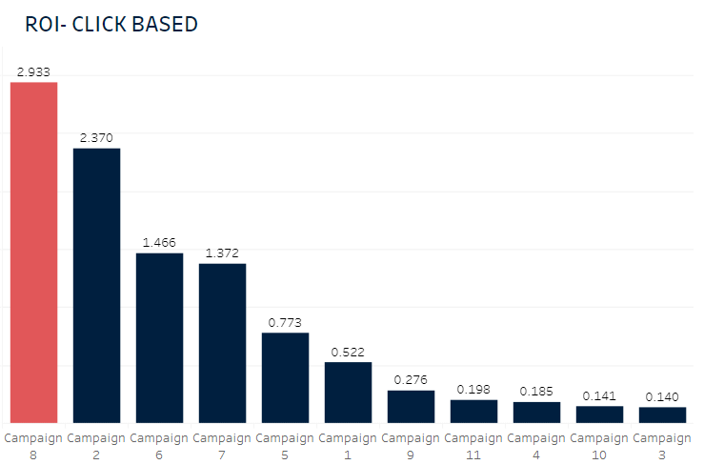
Campaign Efficiency Analysis Contd.
Campaign 3 has the lowest return of investment, with campaigns 10,4,11,9,1 and, 5 all having a return on investment lower than 1%.

Slide 12
Cost Efficiency (CPC and CPR) & Ad Efficiency(CTR & Unique CTR)
Best Performing Campaign:
Campaign 8 had the lowest CPC (1.04 INR) and CPR (2.69 INR), coupled with the highest ROI of 2.933. It achieved an impressive CTR of 29.56% and a unique CTR of 28.08%.
Worst Performing Campaigns:
Campaigns 3 and 10 had the highest CPC (2.376 INR) and CPR (6.932 INR), with poor CTR
(13.06% and 22.36%, respectively).
Campaign 7 also performed poorly with a CTR of 6.709% and a unique CTR of 12.23%, despite a moderate CPC of 2.17 INR and CPR of 5.99 INR.

Slide 13
Insights
Strong Campaigns:
Campaign 8 stood out as the most efficient, delivering high returns and engagement at a minimal cost. Campaign 2 excelled in impressions and reach, indicating strong audience visibility.
2. Underperforming Campaigns:
Campaigns 3, 4, 10, and 11 showed the weakest performance in impressions, reach, and cost efficiency.
Campaign 7, while generating higher impressions and reach, performed poorly in cost metrics (CPC, CPR) and ROI.
Ad Spend Efficiency:
Campaign 8 maximize ROI with a modest spend (943 INR), demonstrating an effective allocation resources. Campaign 1, despite high spend, did not show proportionate efficiency in ROI or cost metrics.

Slide 14
Conclusion
Drop Campaigns 3, 10, and 11:
These campaigns underperformed significantly in both engagement and cost efficiency. Resources can be better allocated to stronger campaigns.

